Slide 1

Armed Forces College of Medicine
AFCM

Slide 2
Diseases of Pleura

Slide 3

INTENDED LEARNING OBJECTIVES (ILO)
By the end of this lecture the student will be able to:
Define and identify the etiology asbestos-related lung diseases
Define and identify pathophysiology of pneumothorax
Classify pneumothorax
Recognize clinical picture of a case of pneumothorax
Identify investigations needed for diagnosis
Illustrate Different treatment modalities

Slide 4

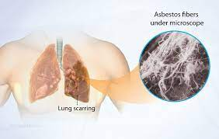
Asbestos-Related Pleural Disease and Mesothelioma
Etiology and Pathophysiology
• non-malignant manifestations of asbestos exposure:
■ non-malignant asbestos pleural effusion
◆ exudative effusion, typically ~10 yr after exposure, resolves
◆ pleural cytology is needed to distinguish this from mesothelioma or pleural extension of other malignancies
■ pleural plaques, usually calcified
◆ marker of exposure; usually an asymptomatic radiologic finding
• mesothelioma
■ primary malignancy of the pleura
■ decades after asbestos exposure (even with limited exposure)
■ smoking not a risk factor, but asbestos and smoking synergistically increase risk of lung cancer

Slide 5
Signs and Symptoms
• persistent chest pain, dyspnea, cough, bloody pleural effusion, and weight loss
• in the instance of mesothelioma, there can be associated paraneoplastic syndromes (e.g. hypercalcemia, hemolytic anemia, hypoglycemia)

Slide 6

Mesothelioma (Primary pleural tumor)
Definition: Tumor arising from the mesothelial lining of the pleura or other serous mesothelial membranes.
Types:
Benign: solitary fibrous tumor (localized):
fibrous tumor attached to pleura.
Grossly: firm grayish white localized circumscribed mass.
Microscopically: bland, plump, spindled cells with a so-called patternless architecture that surround branching blood vessels.

Slide 7
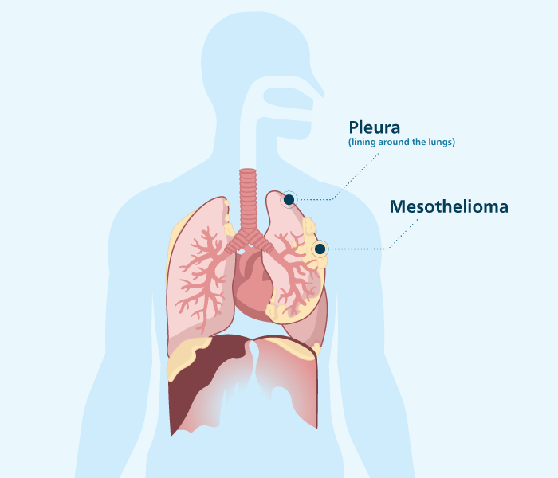
Mesothelioma
Malignant Mesothelioma (diffuse): Arising from the visceral or parietal pleura. The tumor increases with increased exposure to ASBESTOS (occurs after 20 years).
It is a very aggressive malignant
tumor of mesothelial cells
of visceral or parietal pleura.
https://www.google.com/url?sa=i&source=images&cd=&ved=2ahUKEwjT6dSZvOLjAhUHHxoKHZjHCd0QjRx6BAgBEAQ&url=https%3A%2F%2Fwww.asbestos.com%2Fmesothelioma%2F&psig=AOvVaw0ygFP8LXKXJwov3ySJNPLF&ust=1564776282929831

Slide 8
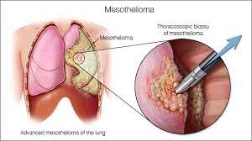
Mesothelioma

Slide 9

Malignant Mesothelioma
Grossly:
soft gelatinous diffuse grayish pink tumor tissue.
Microscopically:
may be either:
1- Sarcomatoid type formed of spindle shaped sarcomatoid cells.
2- Epithelial like (carcinomatous) formed of columnar cells arranged in tubular,
acinar or papillary pattern.
3-Biphasic (sarcomatoid and carcinomatous).

Slide 10

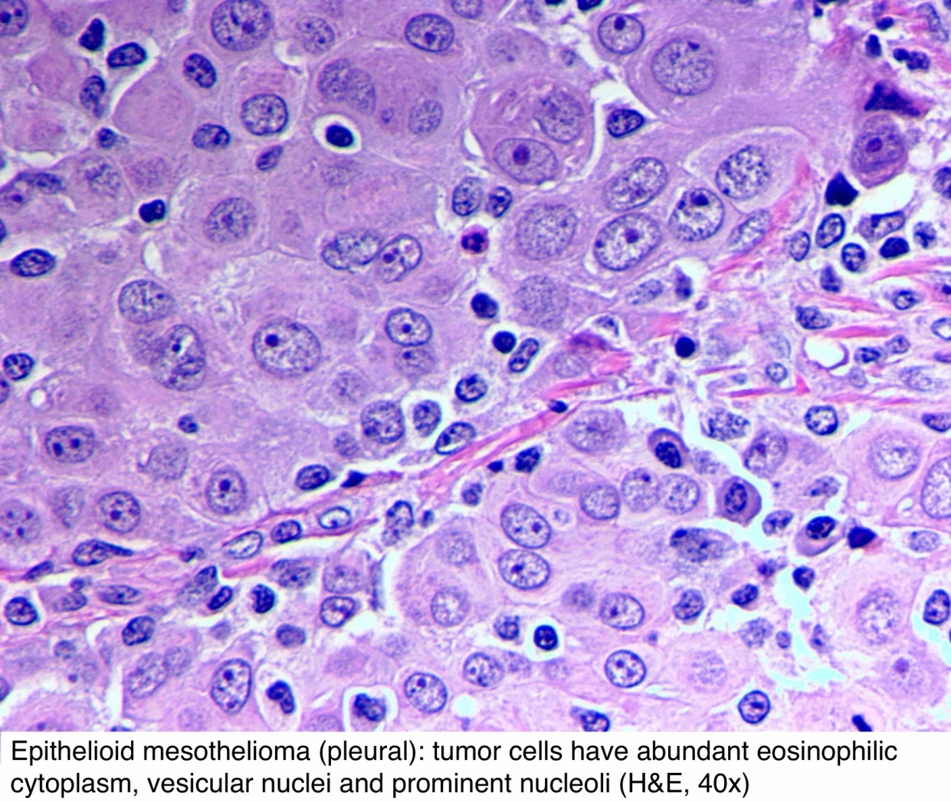
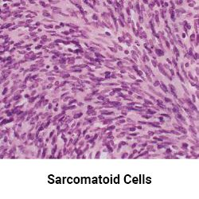
Malignant Mesothelioma
https://www.google.com/url?sa=i&source=images&cd=&cad=rja&uact=8&ved=2ahUKEwjUkaL-vePjAhUPbBoKHXepAtMQjRx6BAgBEAQ&url=http%3A%2F%2Fwww.pathologyoutlines.com%2Ftopic%2Fperitoneummesothelioma.html&psig=AOvVaw05omVHuG2dX60HX5-gufl_&ust=1564810712231960
https://www.google.com/url?sa=i&source=images&cd=&ved=2ahUKEwjOs_WevePjAhVOx4UKHS9VCwgQjRx6BAgBEAQ&url=https%3A%2F%2Fwww.asbestos.com%2Fmesothelioma%2Fcells%2F&psig=AOvVaw05omVHuG2dX60HX5-gufl_&ust=1564810712231960

Slide 11
Investigations
• CT scan
biopsy (pleuroscopic or open)
Treatment
• use of multidisciplinary team with tri modal treatment (e.g. chemotherapy, radiation, surgical resection)
• palliation is often needed because of poor prognosis

Slide 12

Metastatic tumors of pleura (Secondary Pleural Tumors)
Pleural Metastasis:
Common tumors.
Reach the pleura by lymphatics and blood mainly from breast carcinoma and bronchogenic carcinoma

Slide 13
Pneumothorax

Slide 14
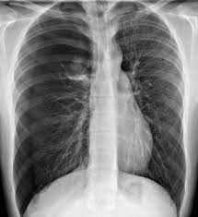
Pneumothorax
Definition
-presence of air in the pleural space
-may lead to various degrees of respiratory compromise
Pathophysiology
entry of air into pleural space raises intrapleural pressure causing partial lung deflation; with progression, the intrapleural pressure may exceed atmospheric pressure creating a tension-scenario that:
impairs respiratory function
decreases venous return to the right-side of the heart

Slide 15
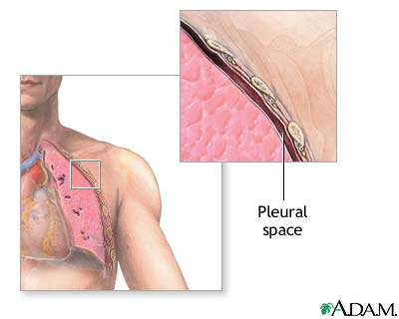
Pneumothorax

Slide 16
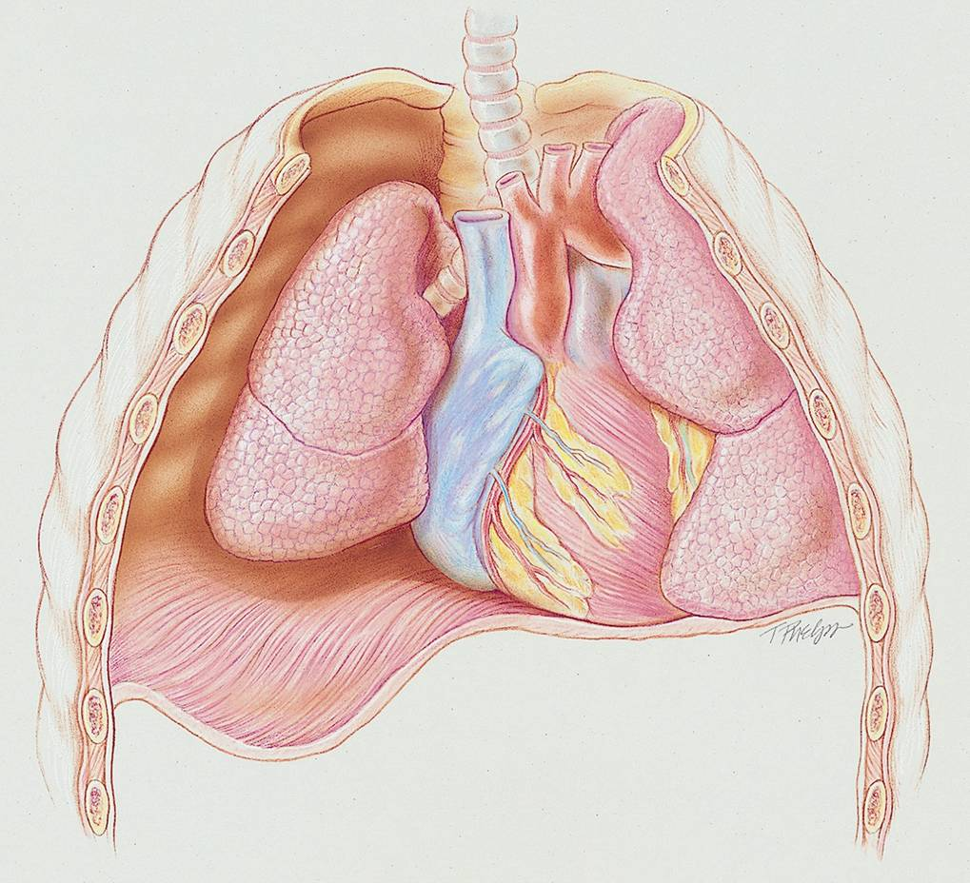
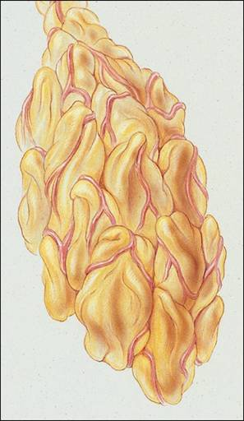
Pneumothorax
CL
GA
DD
Figure 22-1. Right-side pneumothorax. GA, Gas accumulation; DD, depressed diaphragm; CL, collapsed lung. Inset, Atelectasis, a common secondary anatomic alteration of the lungs.

Slide 17
3 Ways
Etiology of pneumothorax
From the lungs through a perforation of the visceral pleura
From the surrounding atmosphere through a perforation of the chest wall and parietal pleura or, rarely, through an esophageal fistula or a perforated abdominal viscus
From gas-forming microorganisms in an empyema in the pleural space (rare)

Slide 18
Anatomic alterations of the lungs
Lung collapse
Chest wall expansion
Compression of the great veins and decreased cardiac venous return

Slide 19
Classification of pneumothorax
( Based on origion )
Traumatic pneumothorax
Spontaneous pneumothorax
Iatrogenic pneumothorax

Slide 20
Classification system
Spontaneous Pneumothorax
Primary
Secondary
Traumatic Pneumothorax
Non- Iatrogenic
Iatrogenic

Slide 21
Primary spontaneous pneumothorax
A disease of younger individuals (15 - 35 yrs of age)
males > females
tall, slim body habitus
usual cause: parenchymal blebs in the:
apex of the upper lobe

Slide 22
Secondary spontaneous pneumothorax
due to underlying pulmonary disease
COPD / Asthma / Cystic Fibrosis
Immunocompromised Infections

Slide 23
Traumatic pneumothorax
Due to:
Blunt or Penetrating trauma
Iatrogenic
central lines / pleural aspiration / pleural biopsy
endoscopy / dilational techniques
Barotrauma: Mechanical Ventilation

Slide 24
Open pneumothorax
Large defect
Removes normally negative intra-thoracic pressures - thus impedes respiration
Prompt closure - sterile, occlusive
Surgery usually required

Slide 25
Tension pneumothorax
Progressive air pressure within chest impairing venous return.
Life threatening emergency

Slide 26
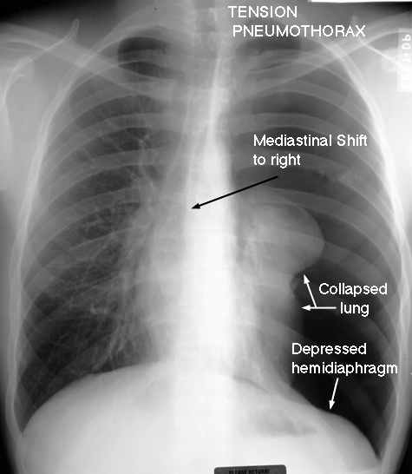
Signs and Symptoms
• acute-onset pleuritic chest pain, dyspnea
• tachypnea, tachycardia.
• ipsilateral diminished chest expansion.
• Contralateral tracheal deviation
• decreased tactile/vocal fremitus.
• hyperresonance.
• ipsilateral diminished breath sounds.

Slide 27
Investigations
• Chest X-Ray
■ small: separation of visceral and parietal pleura seen as fine crescentic line parallel to chest wall at apex
■ large: decreased density and decreased volume of lung on side of pneumothorax

Slide 28
Pneumothorax Imaging

Slide 29
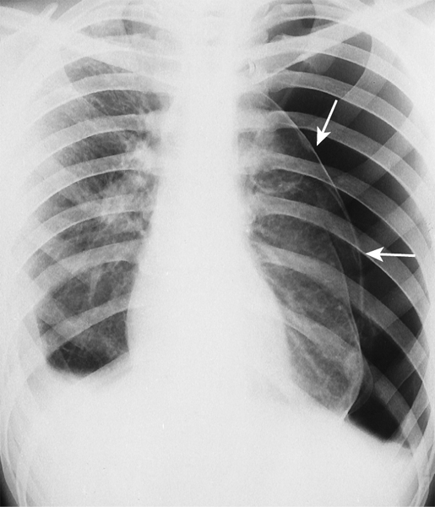
Pneumothorax Imaging
Figure 22-9. Left-sided pneumothorax (arrows). Note the shift of the heart and mediastinum to the right away from the tension pneumothorax.

Slide 30
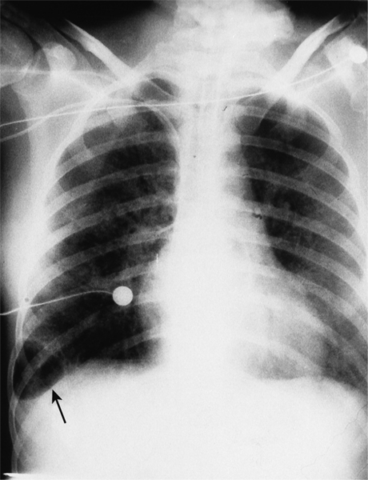
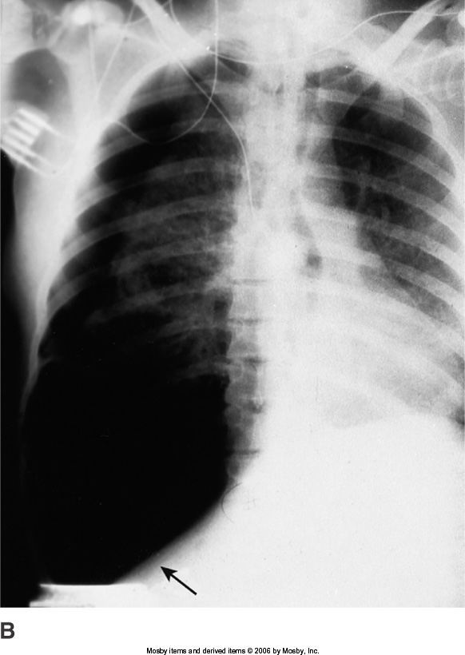
Pneumothorax Imaging
A
B
Figure 22-10. A, Development of a small tension pneumothorax in the lower part of the right lung (arrow). B, The same pneumothorax 30 minutes later. Note the shift of the heart and mediastinum to the left away from the tension pneumothorax. Also note the depression of the right hemidiaphragm (arrow).

Slide 31
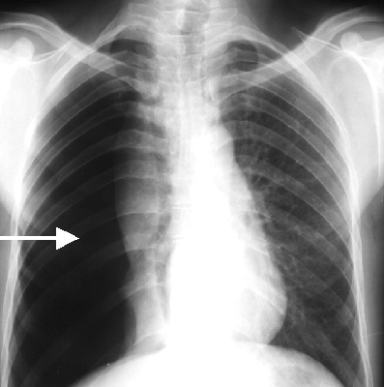
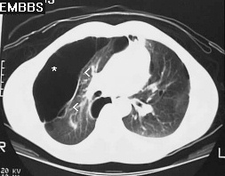
Pneumothorax
Pneumothorax Imaging

Slide 32
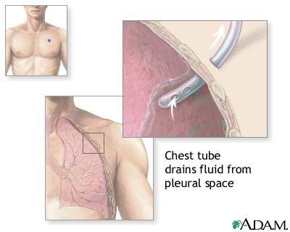
Management of pneumothorax
(1) General management:
First: evacuate the air
Second: address the underlying source
2) Treatment Options
Observation: Inpatient versus Outpatient:
Thoracostomy Drainage (Tube replacement ):

Slide 33
Management of pneumothorax
• primary spontaneous pneumothorax
■ stable, small (<3 cm), minimal symptoms: observation + O2
■ symptomatic or large (>3 cm): aspiration
■ unstable/tension pneumothorax: needle decompression then chest tube, and VATS if unsuccessful (25-50%) •
• secondary spontaneous pneumothorax
■ stable, small (<3 cm), minimal symptoms: observation + O2
■ symptomatic, large, or unstable: chest tube, and VATS if unsuccessful

Slide 34
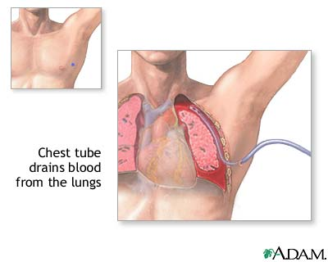
Management of pneumothorax

Slide 35
Management of pneumothorax
PLEURODESIS
Chemical or medication injected into the chest cavity
Talc
Tetracycline
Bleomycin sulfate
Produces inflammatory reaction between lungs and inner chest cavity
Causes lung to stick to chest cavity

Slide 36
References
Pleural Diseases | Michigan Medicine (uofmhealth.org)
Kaplan Medical step 1, lecture notes in Pathology: Chapter 14, Respiratory system , pp. 125-143, 2017

Slide 37
Thank you

